Slide 1
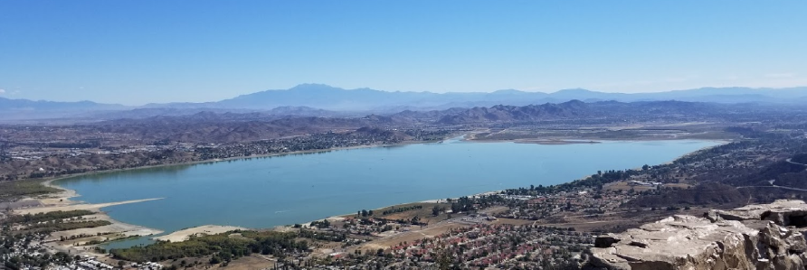
Artificial Intelligence (AI) system with drone/GPS to monitor HAB
Submitted by: Santiago Cabalquinto Jr, IT-PM
Submitted on: Nov 11, 2020
Contact Email: santiagojr@grumpyamoeba.com
Contact Phone: 909-204-0229

Slide 2
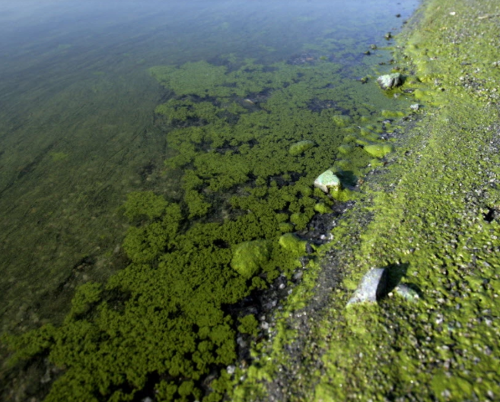
Introduction – 1:50p – 2:10p, 11/12/20
1:50pm – Project Approach
2:05pm – Q&A
Background:
Lake Elsinore is a freshwater lake with 10-billion US gallons or 30,000 acres-feet, 6 miles long and 1.5 miles wide, with average depth of 27 feet (source: wiki)
Audience: Travis Hinkelman, (Senior Data Scientist @ ESA), California Water Monitoring Council (lyris@swrcb18.waterboards.ca.gov), Data Science PWT
Me: Technical Project Manager, DBA, Software developer
Notes:
May require more than one slide

Slide 3
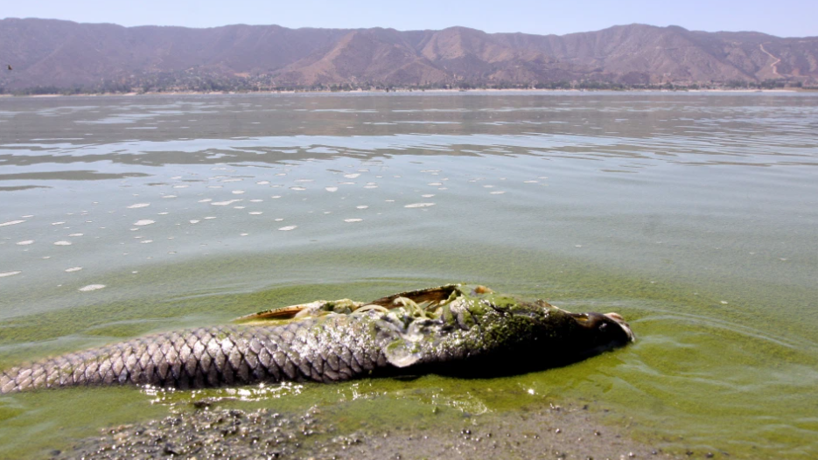
Project Approach – Simple, High Level
Baseline – Where are we now?
Project Goals – Where do we want to go?
Implementation – How do we get there?
Monitor and Control – Are we there yet?
Notes:
May require more than one slide

Slide 4
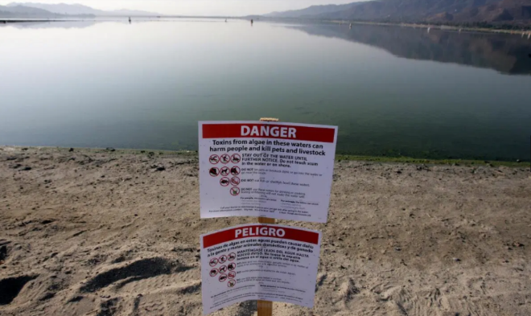
1. Baseline – Where are we now?
Historical Information: Lake Elsinore has had water quality problems from excess nutrient runoff that triggers severe algal bloom, low dissolved oxygen levels, massive fish kills, sewer type odors … (source: Prop-40 Wetland Enhancement Grant)
Most recent Harmful Algal Bloom (FHAB) SWAMP report, dated 9/4/2020, Lake Elsinore received “Caution” at Perret Park , and “Danger” at Inlet Channel.
Current Remediation Effort: Aluminum Sulfate, Aeration, addition of 5 million gallons of recycled water per year (source: lake-elsinore.org)
Notes:
May require more than one slide

Slide 5
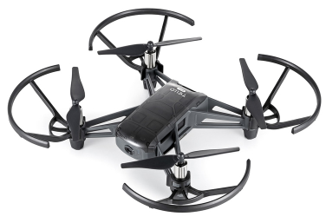
2. Project Goals – Where do we want to go?
Design, develop and deploy a prototype AI-drone solution to monitor, report and alert Harmful Algal Bloom (HAB) levels and locations
Achieve success criteria:
Autonomous AI-drone monitoring, 24/7
AI-GPS predictive alerts (e.g. Green, Yellow, Red), 24/7
Automated notification per Service Level Agreements (SLA)
Request approval from stakeholders
Next Step, if prototype is approved:
Design, develop and deploy a full-scale AI-drone solution, with infrared/thermal camera, for the entire lake (see note #4);
Build all-natural algal bloom filtration system (see note #1, #2)
Notes:
May require more than one slide

Slide 6
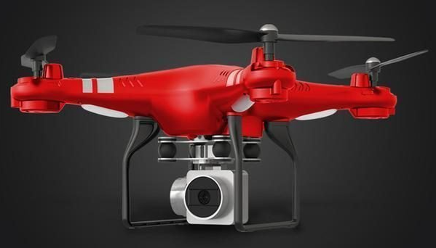
3. Implement Prototype – How do we get there? (part 1)
Design Considerations:
Open source, reliable and scalable
Secured with Identify Access Mgmt (IAM)
Revenue positive: Remove Algal naturally (see Note #1)
Prototype Components:
Splash Drone/GPS with 1080p camera live video (max 120 meters, < 250g)
DJI Tello Drone/GPS with 1080p camera live video (max 300 m, <250g)
Google cloud platform (GCP)
AI using r-google-analytics
Chromebook laptop for uploading images from drone to GCP
Dronedeploy.com for 3D image reconstruction/stitching
Notes:
May require more than one slide

Slide 7
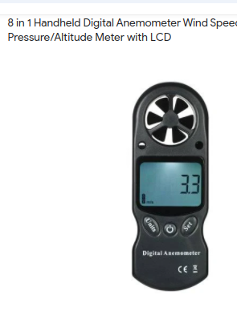
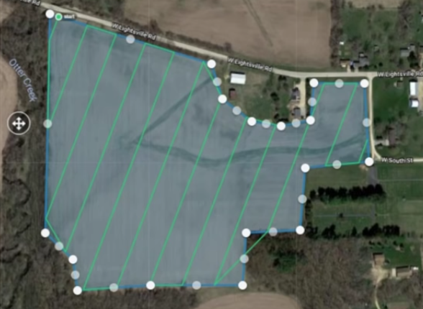
3. Implement POC – How do we get there? (part 2)
Use Cases:
Data points: environmental conditions using an anemometer: air velocity, air temperature, barometric, humidity
If “safe to fly”, start drone flight from “HOME”
Fly pre-programmed flight path
Capture images + GPS value + water levels
Return “HOME”; backup images to Google Cloud
Identify nutrient levels (nitrates + phosphates)
Upload images to dronedeploy.com
Copy stitched images back to the Google Cloud
Perform trend analysis on algal bloom location; Communicate alerts
Notes:
May require more than one slide

Slide 8
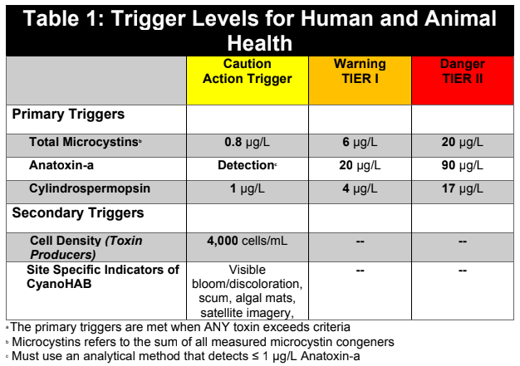
4. Monitor and Control – Are we there yet?
Validate for accuracy:
Validate Wind meter: air velocity, temperature, barometric, humidity
Validate values for drones to “safely fly”
Validate pre-programmed flight path
Validate drone images + GPS + H2O level
Validate security on dronedeploy.com
Validate trend analysis: algal bloom location
Validate Communication Plan
Validate nutrient levels (nitrate, phosphate)
Notes:
May require more than one slide

Slide 9

Thank You! Any questions?
Notes:
May require more than one slide

Slide 10
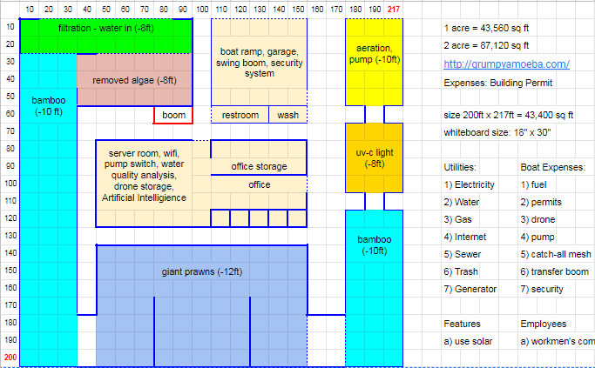
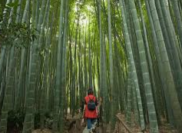
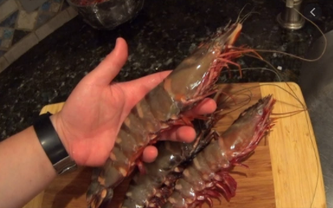
Note #1: All Natural Algal Bloom Remediation: 24/7 Filtration
Size: 200’ x 217’
Scale: 1 square = 10’ x 10’ square feet
Structure will have security surveillance and fence
Moso Bamboo can absorb 12 tons of carbon dioxide per year
Notes:
May require more than one slide

Slide 11
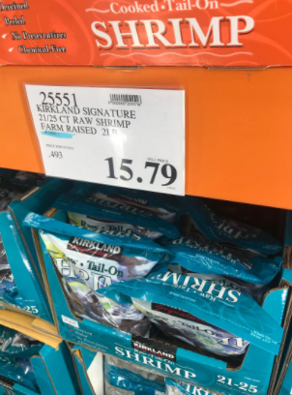
Note #2: Algal Bloom Remediation – Ecological Solution
Short Term Goals (if approved):
Identify key stakeholders from Lake Elsinore’s LESJWA and CCHAB
Collect sample of algal bloom and dry the algal for nutrient analysis
Operate waterproof, GPS drone for birds-eye view of other algal bloom
Use a pontoon boat and sump pump to collect algal bloom
Request use 1-acre lakeside parcel for filtration and to dry collected algal
Dry collected algal bloom to neutralize bacteria and convert it to fertilizer
Long Term Goals (if approved):
Collaborate with key stakeholders on the project requirement, objectives
Validate Project Deliverables, Milestones, Risks, Priorities and Schedule
Build the 24/7 Filtration Structure, with Hydroponics
Notes:
May require more than one slide

Slide 12
Note #3: Algal Bloom Remediation: Permitting Process
Permitting Process to be completed after review process
Identify location of Filtration Structure prior to permitting process
Identify building and construction cost and duration
Notes:
May require more than one slide

Slide 13
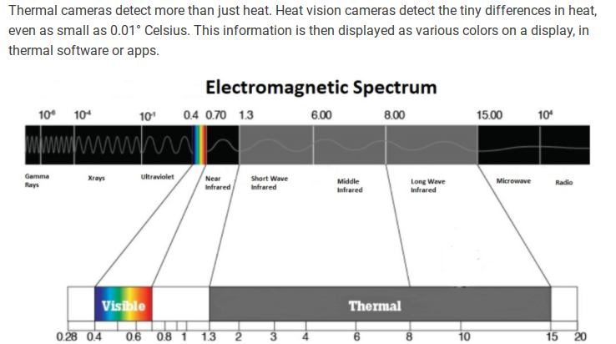
Note #4: Algal Bloom detection using Thermal cameras
Notes:
May require more than one slide

